Slide 1


Sales Forecasting Report using Multiple Linear Regression
Supervised by : Mr.Abdelkamel ALJ
Realized by: Mohamed izeria and douaa mraikh

Slide 2
Introduction to Sales Forecasting
Sales forecasting is a critical process for businesses of all sizes, allowing them to anticipate future demand, plan inventory and production, and make informed strategic decisions. By leveraging historical sales data, market trends, and other relevant factors, companies can generate accurate sales projections that enable them to optimize their operations, allocate resources efficiently, and stay ahead of the competition.
In this presentation, we will explore the power of multiple linear regression, a sophisticated statistical technique, to uncover the key drivers of sales and generate reliable sales forecasts. Through a step-by-step approach, we will dive into the underlying assumptions, data preparation, model building, and interpretation of results, equipping you with the knowledge to leverage this powerful tool in your own business.

Slide 3
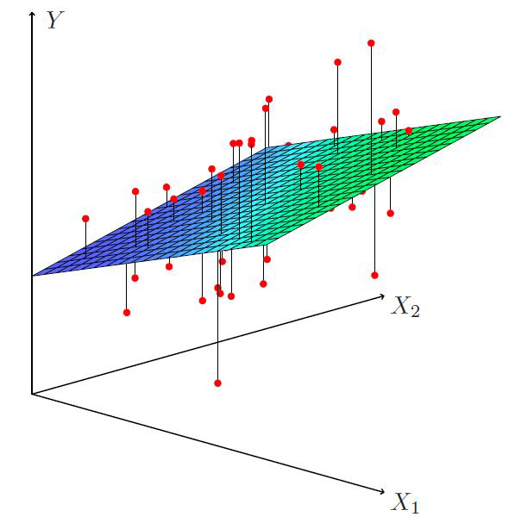
Overview of Multiple Linear Regression
Multiple linear regression is a powerful statistical technique used to model the relationship between a dependent variable (such as sales) and two or more independent variables (also known as predictors or features). This approach allows businesses to understand how various factors, such as marketing spend, product pricing, or economic conditions, influence their sales performance. By quantifying the impact of each predictor, companies can gain valuable insights that inform their strategic decision-making and resource allocation.
Unlike simple linear regression, which considers only a single independent variable, multiple linear regression can capture the complex and multidimensional nature of real-world business scenarios. This advanced technique enables organizations to develop more accurate and comprehensive sales forecasts by accounting for the interdependencies and interactions between different drivers of sales. By leveraging the power of multiple linear regression, businesses can unlock a deeper understanding of their sales data and make more informed, data-driven decisions.

Slide 4
Assumptions of Multiple Linear Regression
To ensure the validity and reliability of a multiple linear regression model, several key assumptions must be met. These assumptions help confirm that the model accurately represents the underlying relationships between the dependent variable (sales) and the independent variables (predictors).
Linearity: The relationship between the dependent variable and each independent variable should be linear. This means that the change in the dependent variable is proportional to the change in the independent variable.
Independence: The observations in the dataset must be independent of one another. This means that the value of one observation does not depend on the value of another observation.
Homoscedasticity: The variance of the residuals (the difference between the observed and predicted values) should be constant across all levels of the independent variables. This assumption ensures that the model's predictions are equally reliable throughout the range of the data.
Normality: The residuals should follow a normal distribution, with a mean of zero and a constant variance. This assumption is important for the validity of statistical inferences, such as hypothesis testing and confidence intervals.
Multicollinearity: The independent variables should not be highly correlated with one another. Excessive multicollinearity can lead to unstable and unreliable regression coefficients, making it difficult to assess the individual contribution of each predictor.

Slide 5
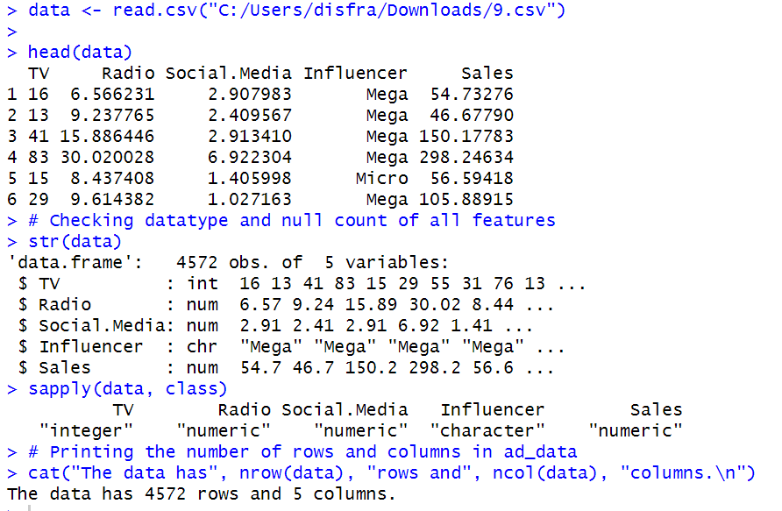
Data Preparation and Feature Selection
Data Cleaning
Before building a multiple linear regression model, it's crucial to thoroughly clean and prepare the data. This involves handling missing values, removing outliers, and ensuring the data is in the correct format. Careful data cleaning helps improve the model's accuracy and reliability by ensuring the input features are of high quality and representative of the real-world scenario.

Slide 6
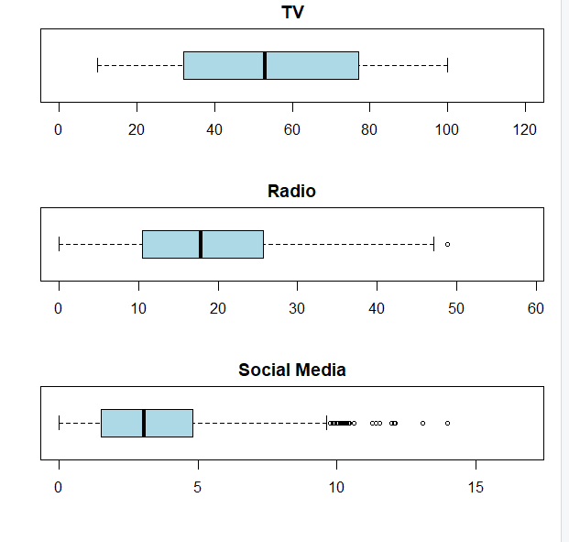
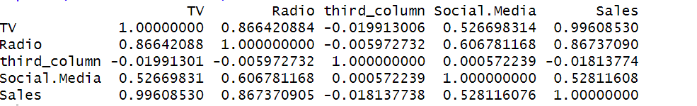
Data Preparation and Feature Selection
Feature Engineering
Feature Selection
Feature engineering is the process of creating new input features from the existing data. This can involve transforming variables, creating interactions between features, or extracting relevant information from unstructured data. Effective feature engineering can significantly enhance the predictive power of the multiple linear regression model, enabling it to capture the complex relationships within the data.
With multiple independent variables, it's important to select the most relevant and impactful features for the regression model. Feature selection techniques, such as correlation analysis, stepwise regression, or principal component analysis, help identify the variables that contribute the most to the prediction of the dependent variable (sales). This process ensures the model is parsimonious and focused on the key drivers of sales, improving its interpretability and generalization capabilities.

Slide 7
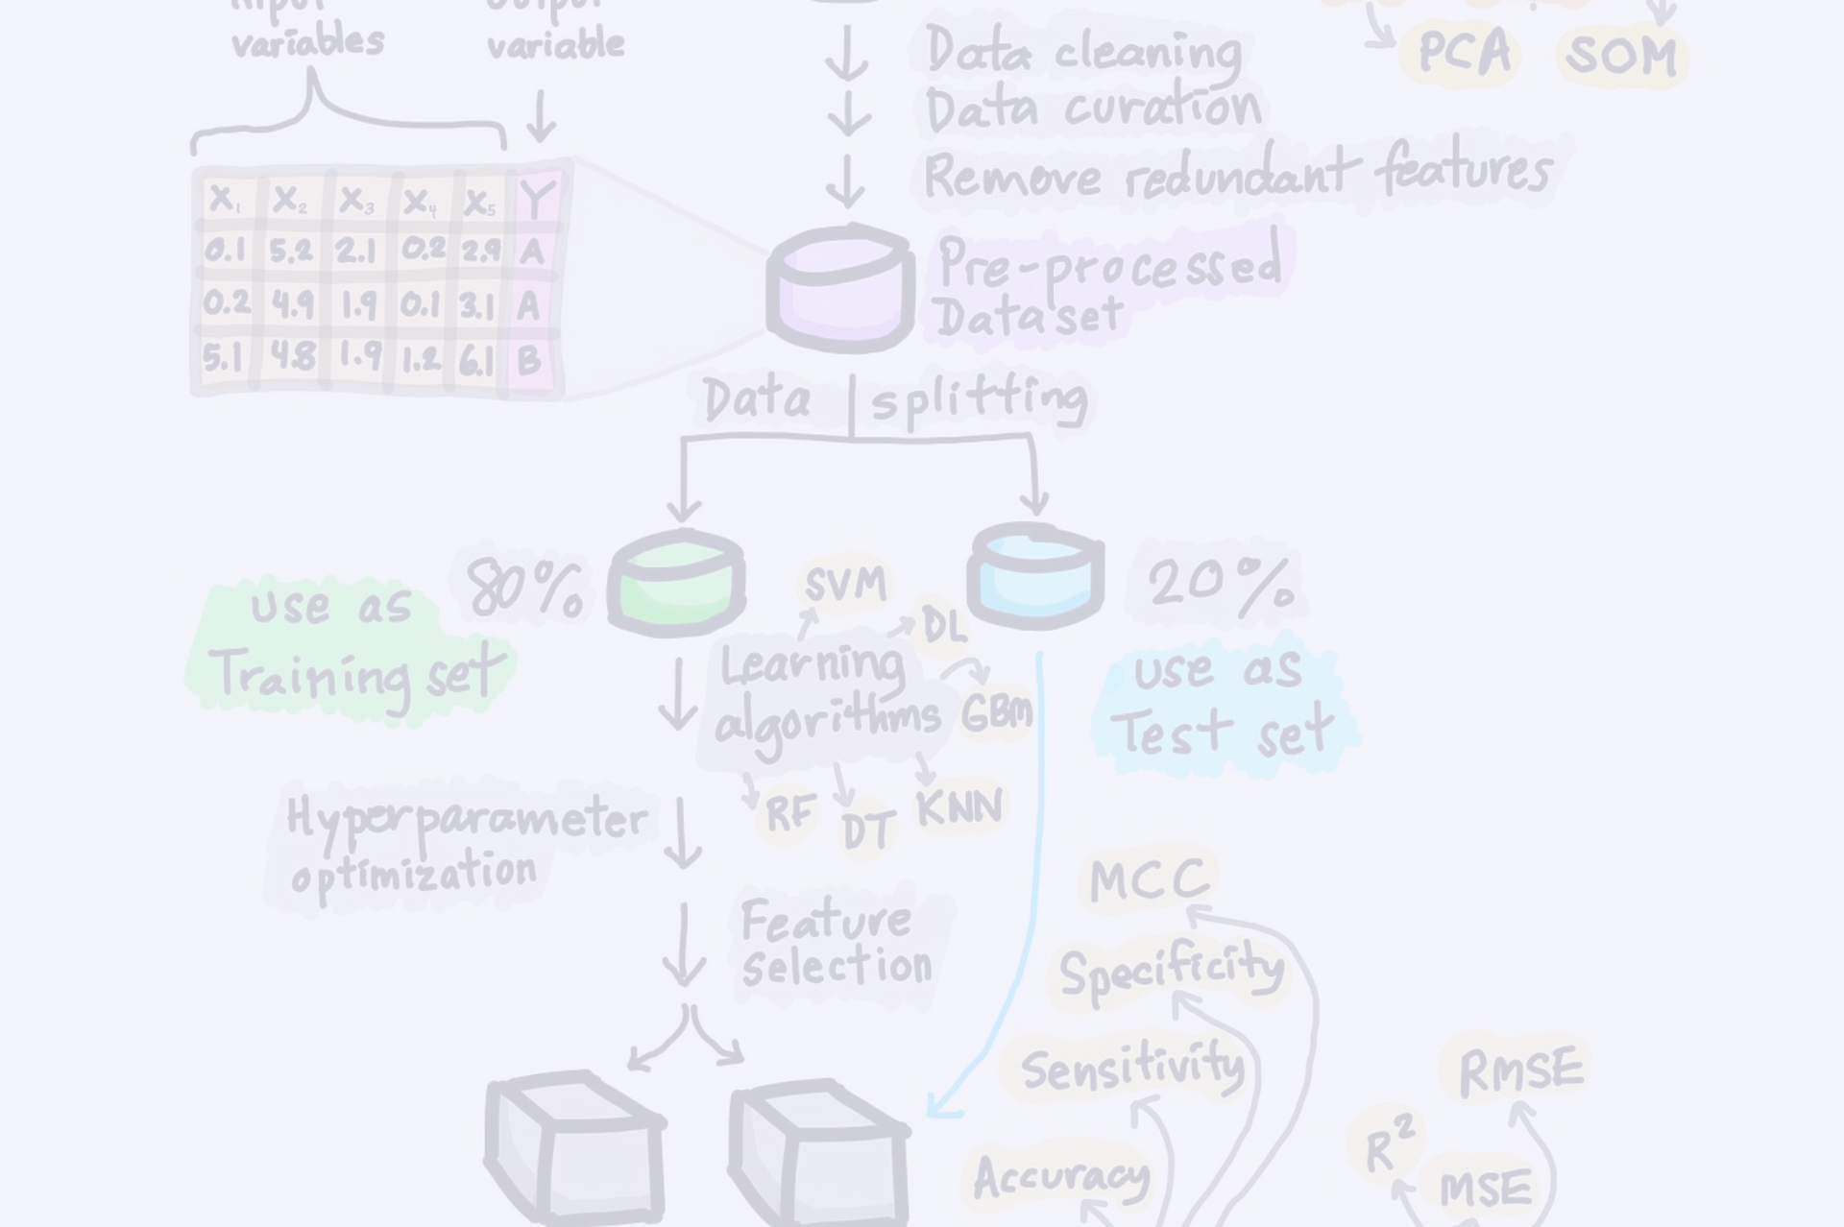
Model Building and Training
Defining the Target Variable
1
The first step in building a multiple linear regression model is to clearly define the dependent variable, or the target variable, that you want to predict. In the context of sales forecasting, this is typically the sales revenue or sales volume. Ensuring a clear and accurate definition of the target variable is crucial, as it will guide the selection of appropriate independent variables and the interpretation of the model's results.
2
Selecting Independent Variables
Based on the insights gained from the data preparation and feature selection process, you can now identify the most relevant independent variables to include in the regression model. These variables should be those that have a significant impact on the dependent variable (sales) and meet the assumptions of multiple linear regression. Carefully considering the theoretical and practical relevance of each predictor will help ensure the model's accuracy and interpretability.
Fitting the Regression Model
3
With the target variable and independent variables defined, you can proceed to fit the multiple linear regression model. This involves using statistical software or programming tools to estimate the regression coefficients, which represent the expected change in the dependent variable (sales) for a one-unit change in the independent variable, while holding all other predictors constant. The model-fitting process must adhere to the assumptions of multiple linear regression to ensure the validity and reliability of the results.

Slide 8
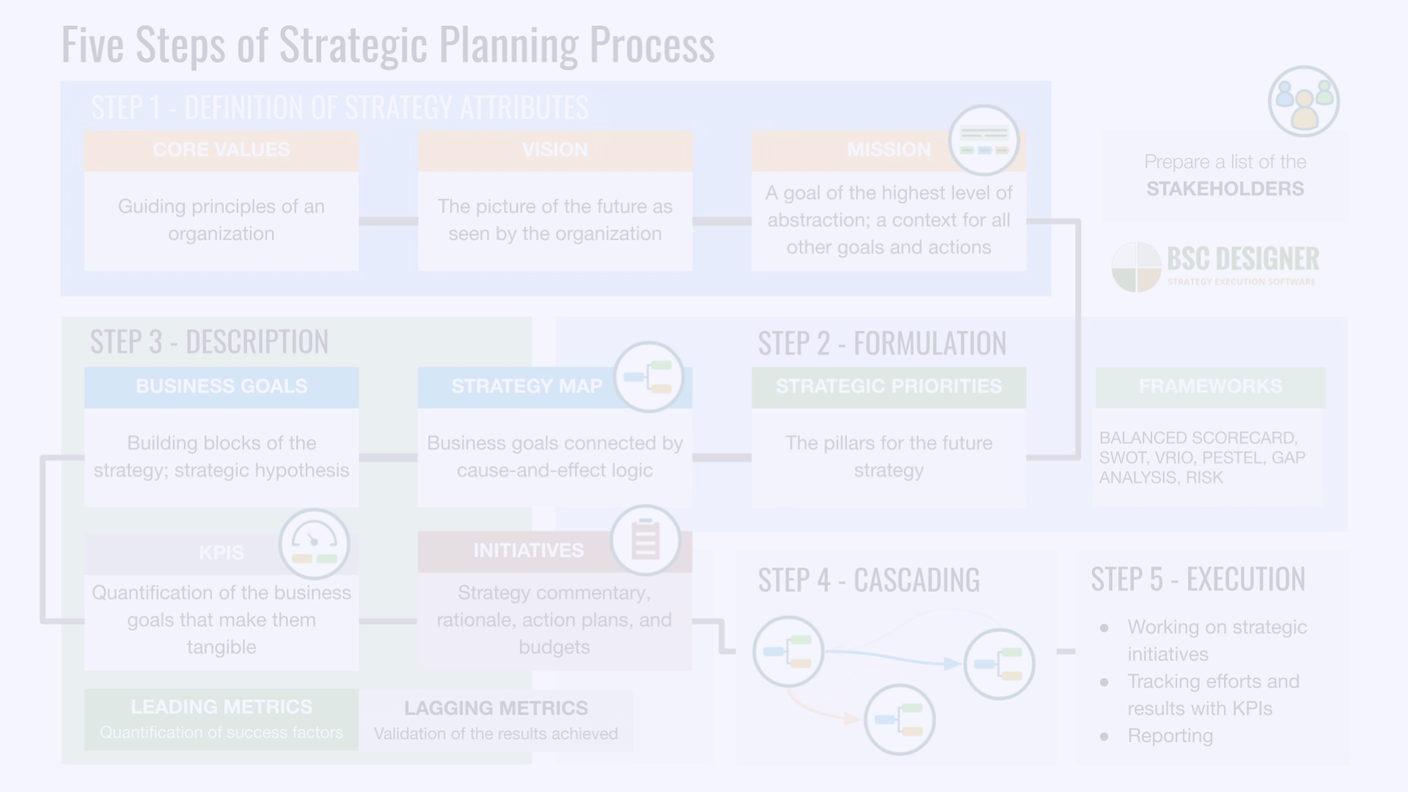
Interpreting Regression Coefficients
The regression coefficients derived from a multiple linear regression model are essential for understanding the relationships between the independent variables and the dependent variable (sales). These coefficients quantify the expected change in sales associated with a one-unit change in each independent variable, while holding all other predictors constant.
The sign of the regression coefficient (positive or negative) indicates the direction of the relationship. A positive coefficient suggests that an increase in the independent variable leads to an increase in sales, while a negative coefficient indicates that an increase in the independent variable is associated with a decrease in sales. The magnitude of the coefficient represents the strength of the relationship, with larger coefficients indicating a more significant impact on sales.
By interpreting the regression coefficients, businesses can gain valuable insights into the key drivers of their sales performance. For example, a high positive coefficient for marketing spend might suggest that investing in additional marketing efforts could significantly boost sales. Conversely, a negative coefficient for competitor pricing might indicate that lowering prices could help increase sales. These insights can inform strategic decision-making and help businesses allocate resources more effectively to achieve their sales goals.

Slide 9
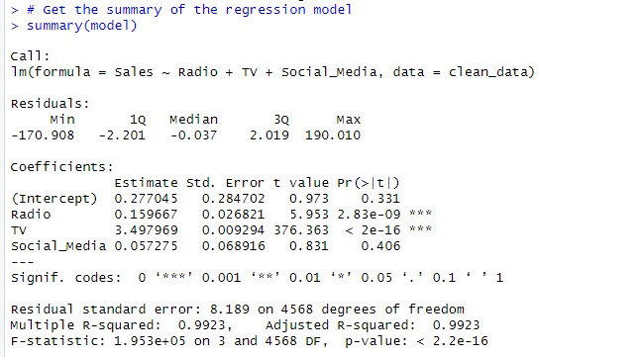
Handling Multicollinearity
Multicollinearity is a common challenge in multiple linear regression, where two or more independent variables are highly correlated with each other. This can lead to unstable and unreliable regression coefficients, making it difficult to assess the individual contribution of each predictor to the dependent variable (sales).
To address multicollinearity, there are several techniques that can be employed. One approach is to identify and remove the redundant variables that are highly correlated with each other, retaining only the most essential and independent predictors. This can be achieved through methods like correlation analysis, variance inflation factor (VIF) calculation, or principal component analysis.
Alternatively, regularization techniques like Ridge Regression or Lasso Regression can be used to shrink the regression coefficients towards zero, reducing the impact of multicollinearity on the model's performance. These methods penalize the complexity of the model, forcing the regression coefficients to be more stable and interpretable.

Slide 10
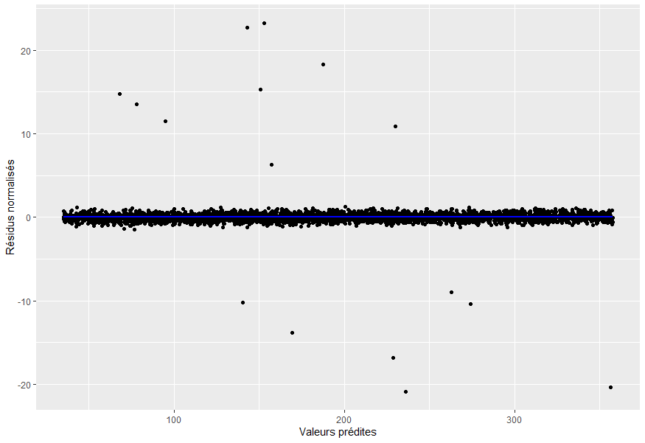
Evaluating Model Performance
Once the multiple linear regression model has been built and trained, it's critical to thoroughly evaluate its performance to ensure the reliability and accuracy of the sales forecasts. This evaluation process involves assessing various metrics and diagnostics that provide insights into the model's ability to capture the underlying relationships in the data and make accurate predictions.
The R-squared and adjusted R-squared values 0.99226 provide a measure of the model's goodness-of-fit, indicating the proportion of the variation in the dependent variable (sales) that can be explained by the independent variables. In this case, the high R-squared values suggest that the multiple linear regression model is effectively capturing the key drivers of sales.
Additionally, the mean absolute error (MAE) and root mean squared error (RMSE) offer insights into the model's predictive accuracy. The lower these values, the better the model's ability to make precise sales forecasts. By analyzing these performance metrics, you can gain confidence in the model's reliability and make informed decisions about its deployment and further refinement.

Slide 11

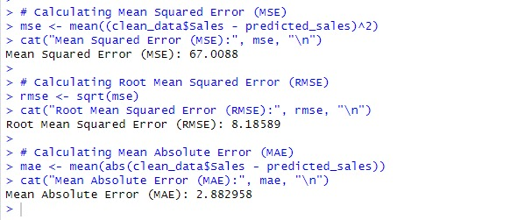
Evaluating Model Performance
The R-squared and adjusted R-squared values provide a measure of the model's goodness-of-fit, indicating the proportion of the variation in the dependent variable (sales) that can be explained by the independent variables. In this case, the high R-squared values suggest that the multiple linear regression model is effectively capturing the key drivers of sales.
Additionally, the mean absolute error (MAE) and root mean squared error (RMSE) offer insights into the model's predictive accuracy. The lower these values, the better the model's ability to make precise sales forecasts. By analyzing these performance metrics, you can gain confidence in the model's reliability and make informed decisions about its deployment and further refinement.

Slide 12
Conclusion and Key Takeaways
Unleash the Power of Multiple Linear Regression
Embrace Data-Driven Forecasting
Multiple linear regression is a sophisticated statistical technique that empowers businesses to uncover the complex relationships driving their sales performance. By modeling the interdependencies between various factors, this approach provides unparalleled insights that can inform strategic decision-making and optimize resource allocation.
Leveraging the predictive capabilities of multiple linear regression, businesses can develop accurate and reliable sales forecasts that enable them to anticipate market trends, prepare for fluctuations, and stay ahead of the competition. This data-driven approach allows companies to make informed decisions and adapt their strategies to capitalize on emerging opportunities.
Prioritize Model Evaluation and Refinement
Unlock Actionable Insights
The interpretation of regression coefficients provides invaluable insights into the key drivers of sales, empowering businesses to make strategic decisions that align with their objectives. Whether it's optimizing marketing investments, adjusting pricing strategies, or mitigating the impact of competitive factors, these insights can help organizations achieve their sales goals and gain a competitive edge.
Continuous evaluation and refinement of the multiple linear regression model are crucial for maintaining its accuracy and relevance. By regularly assessing the model's performance metrics, addressing assumptions, and incorporating new data, businesses can ensure their sales forecasts remain robust and responsive to evolving market conditions.

